Slide 1
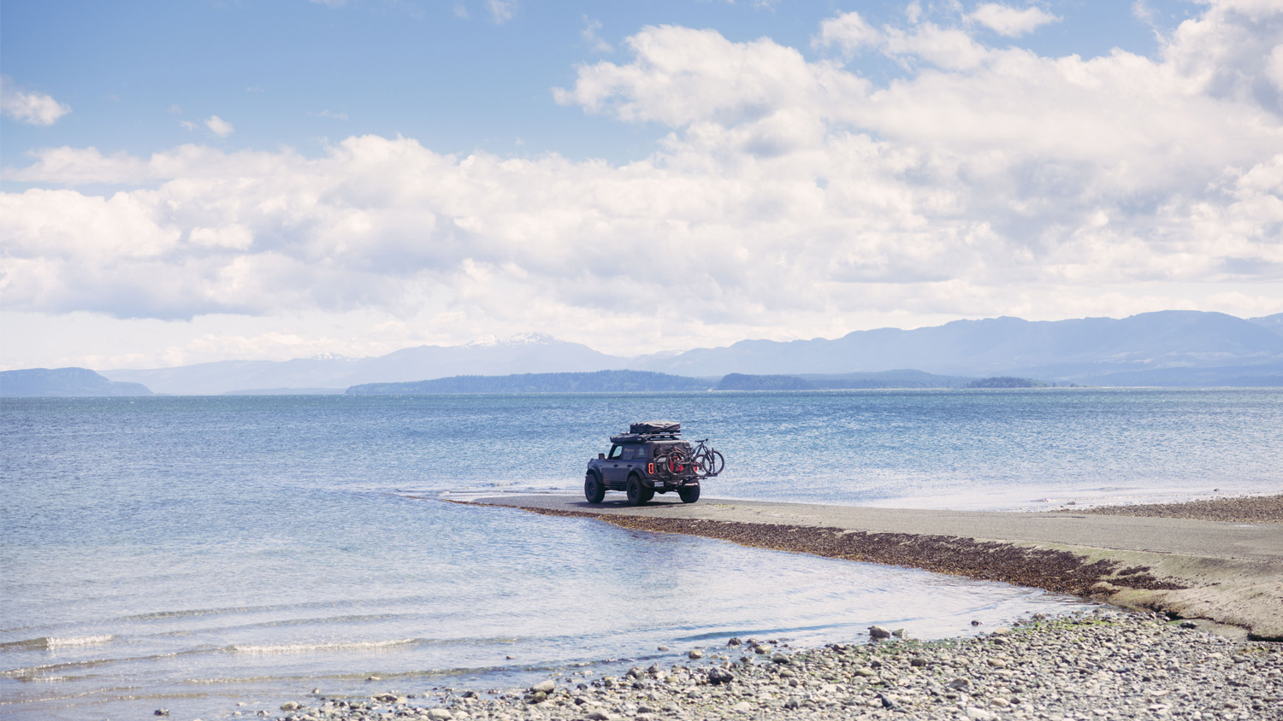

S26 – SUMMER SALES MEETING

Slide 2
2025 ROY Priorities
Short-term Focus
Retail Support & Stabilization
Operational Tightening
Mitigate burden of tariffs and instability
Maintain competitiveness and shelf share
Protect distribution from competition
Build excitement for focused NPI launch
Continue SIOP process refinement
Distribution center cleanup / enhancement
Revised organization / planning function
Continue seeking high reward efficiencies
Systems & Process Advancement
Remain Nimble
Continue progressing enterprise initiatives
Emerge from 2025 with unified systems
ERP, Web platform, Databases, PIMS
Internal controls, External audits, etc.
Adjust appropriately as context shifts
Stay focused on the signal, not the noise
Harness and ride the tailwinds
Work the challenges, don’t create more

Slide 3
Riding The Tariff Wave
New News Everyday
New for 2025
Existing on 1/1/25
232 Tariff
Countries: ALL
HTS: Some
25% of aluminum or steel content
Auto Parts Tariff
Countries: ALL
HTS: Some
25%
Base Tariff
Countries: ALL
HTS: ALL
Typically: 2.5%
301 Tariff
Countries: China
HTS: Some
25%
IEEPA Tariff
Countries: China
HTS: ALL
20%
Total Tariff
Reciprocal Tariff
Countries: ALL
HTS: ALL
% varies. CN=125%, TW=32%
Now at 10% for All Countries

Slide 4

PRODUCT

Slide 5
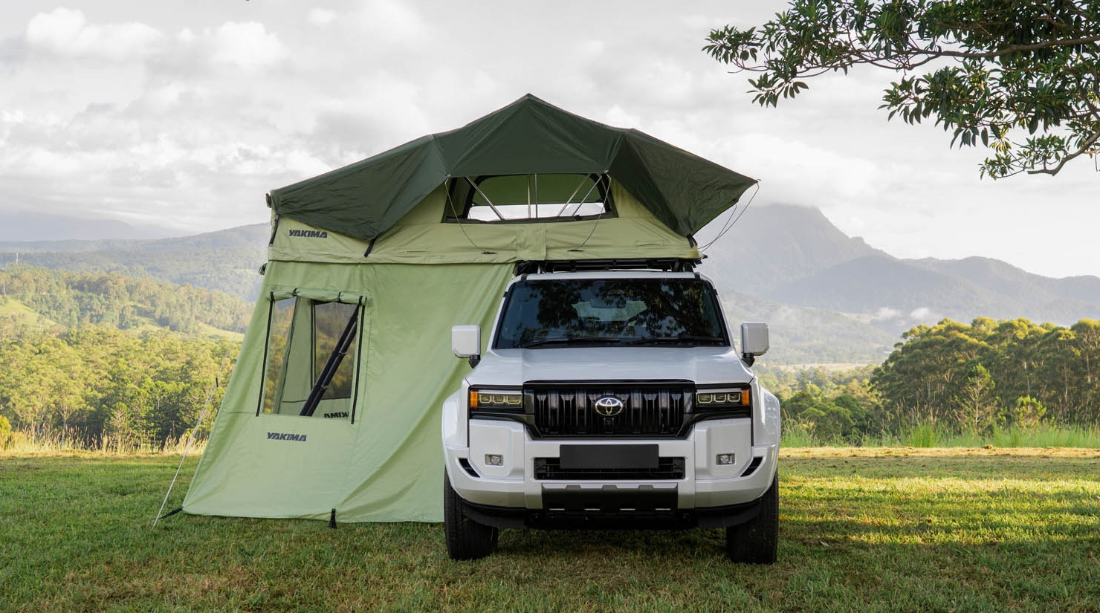
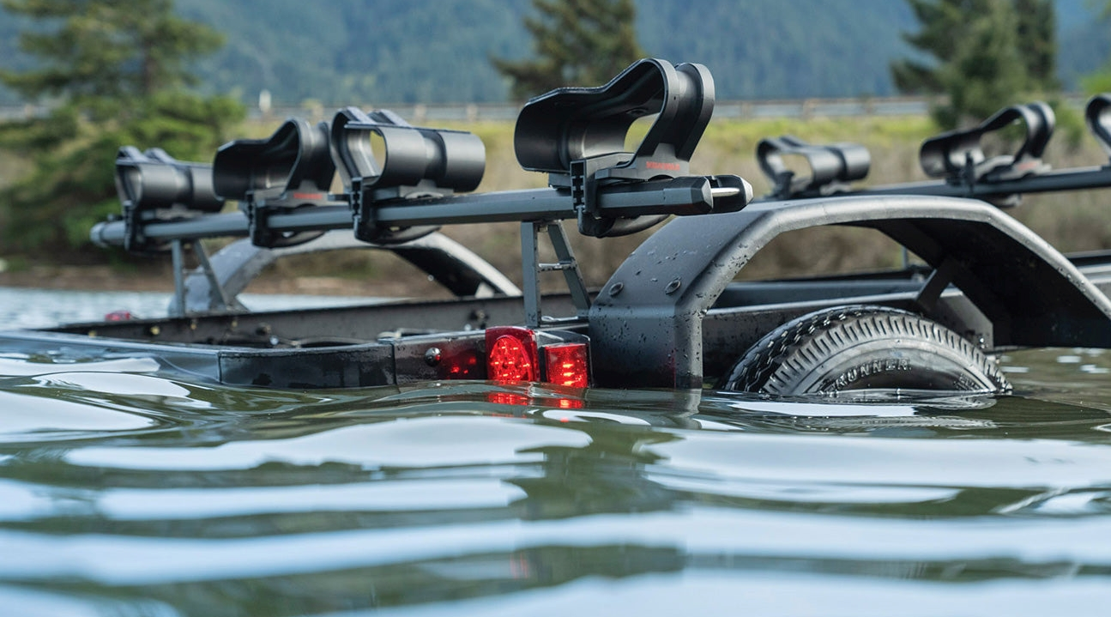
Sp25 Product Launch
Already Shipping
StageTwo
SkyBox NX Skinny & XXL
CBX Obsidian LG & XXL
LowRider & LowRider w/alloy wheels
OverNOut 180 & 270XL Awnings
SkyRise HD & SL
Coming soon
SkyPeak HD available by 7/1

Slide 6
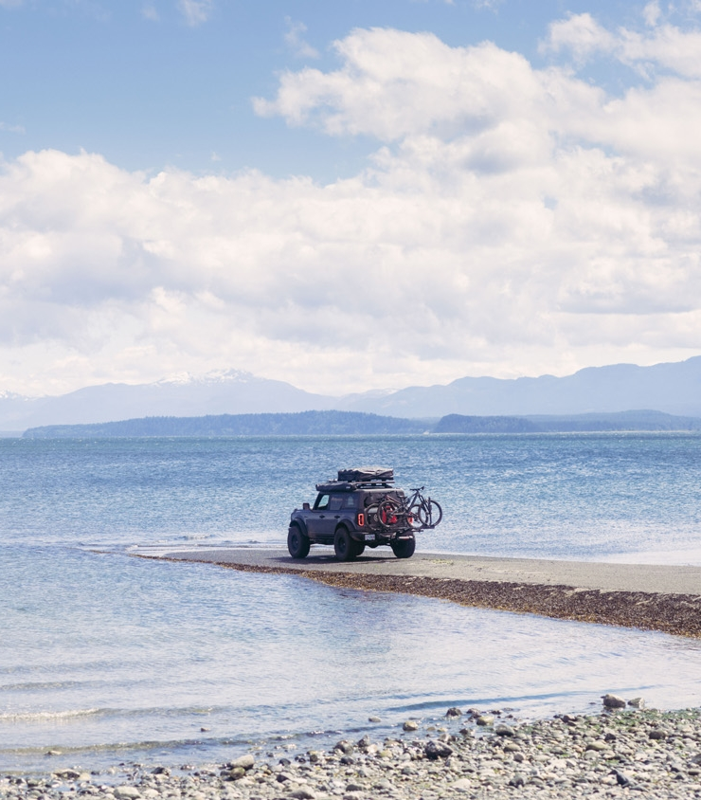
Market Update
…AT LEAST FOR THIS WEEK
The world changes, and we must be agile.
Fast and frequent news
We are, and will be nimble
Market Pricing has shifted (by all)
We are still set up to win

Slide 7
Recent Price Adjustments
OUR APPROACH
APRIL 7th PRICE INCREASE
JUNE 23rd PRICE INCREASE
We moved quickly, to give early visibility to our partners and to cover the immediate impacts on our business from the start of the season.
Initial new tariffs of:
20% + 0-25%
(on China) (on all imported steel/alum.)
Did not include reciprocal tariffs (10-125%)
Did not include auto parts tariff
13% average price increase on 143 SKUs
Increases are blended over the product line, not SKU by SKU
We were ready for full tariff impact, but adjusted down at the last minute with most recent China tariff “pause”.
Accounted for reciprocal tariffs announcements (on Liberation Day)
Planned for 125% reciprocal China tariff, but then were retracted
6.6% average price increase on 87 SKUs
Goal to recover margin, but remain competitive
Some cases we held price, to gain share
Still shouldering all the tariff impact, with much lower margins than normal

Slide 8
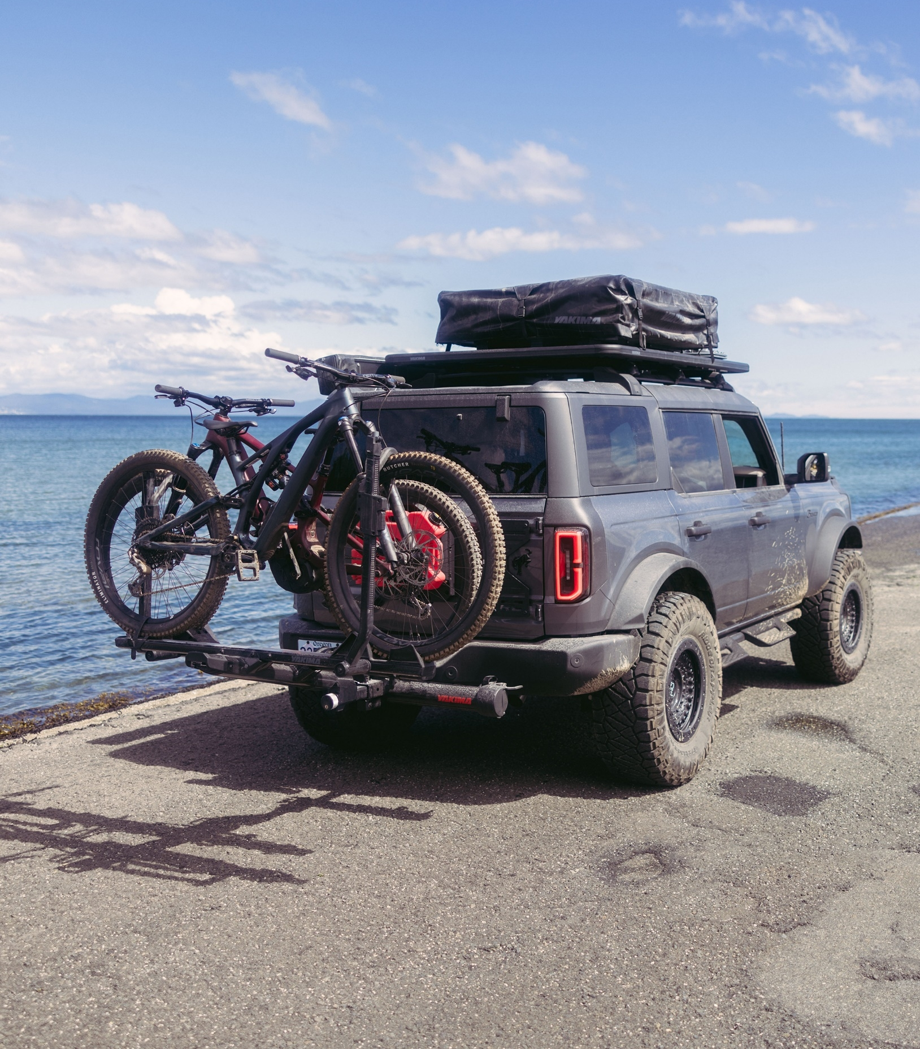
Recent Adjustments
Summary of our recent price changes for 6/23
87 SKUs Increased, 6.6% average increase
Camp, 12 SKUs, +5.6% avg.
Roof Racks, 39 SKUs, +5.1% avg.
Bike, 21 SKUs, +8.2% avg.
Truck Accessories, 3 SKU’s, +8.4% (not OverHaul)
Water/Fish, 7 SKUs, +9.3% avg. (not JayLow)
EXO GearLocker & GearWarrior, +3.5% avg.
Baskets, 3 SKU’S, +3.0% avg.
No June increases: JayLow, OverHaul, SkyBox NX, CBX, EXO, trailers, snow

Slide 9
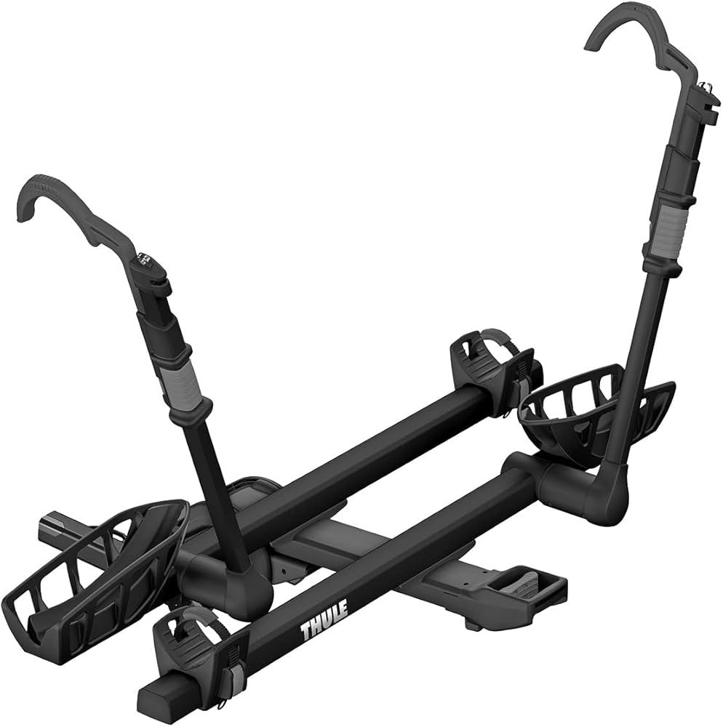
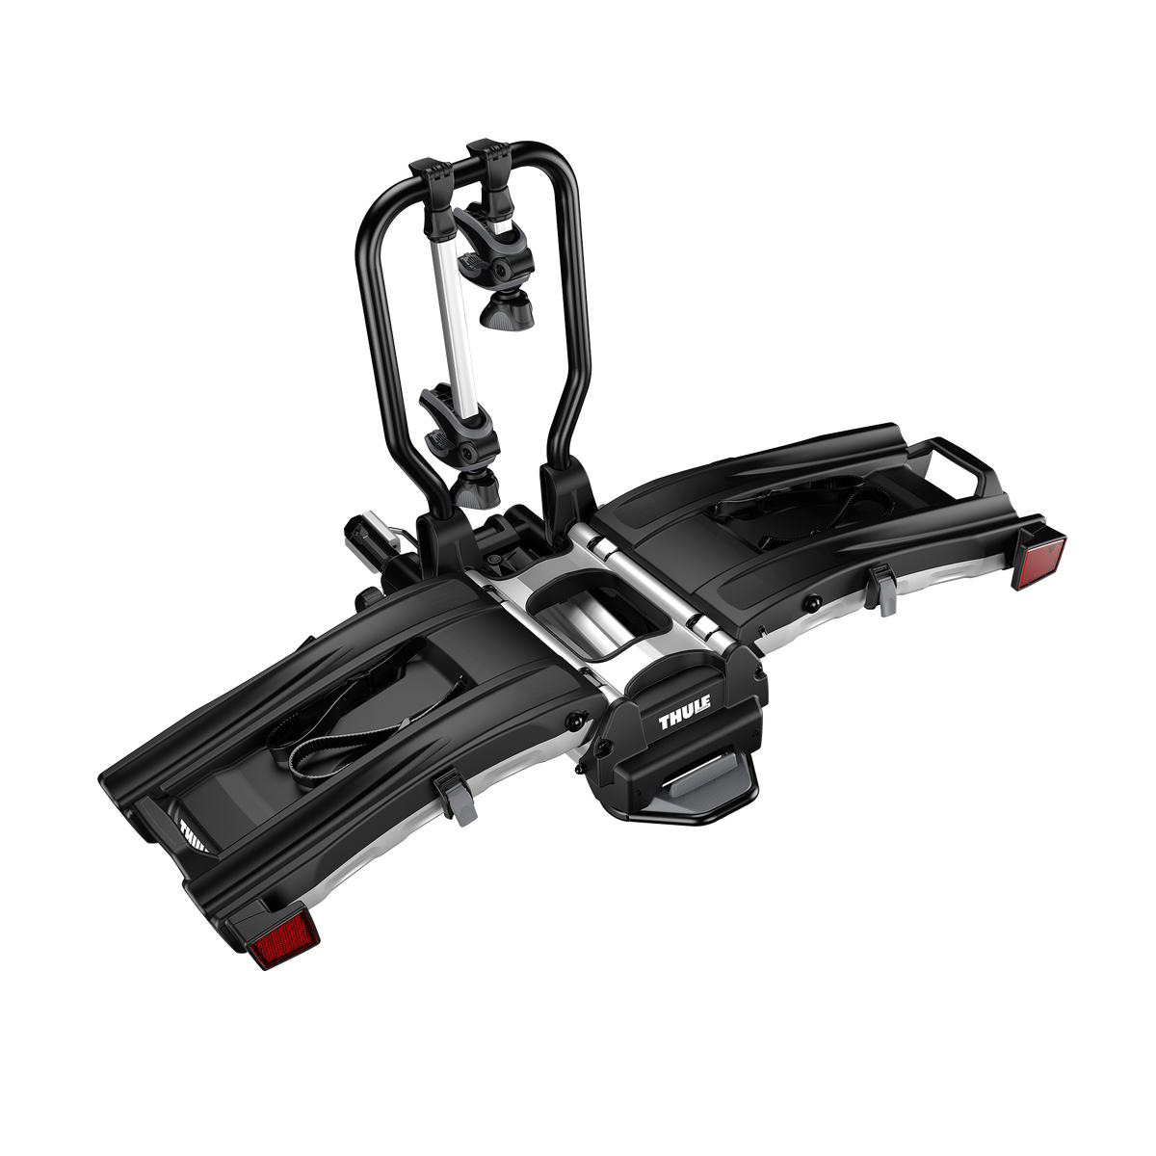
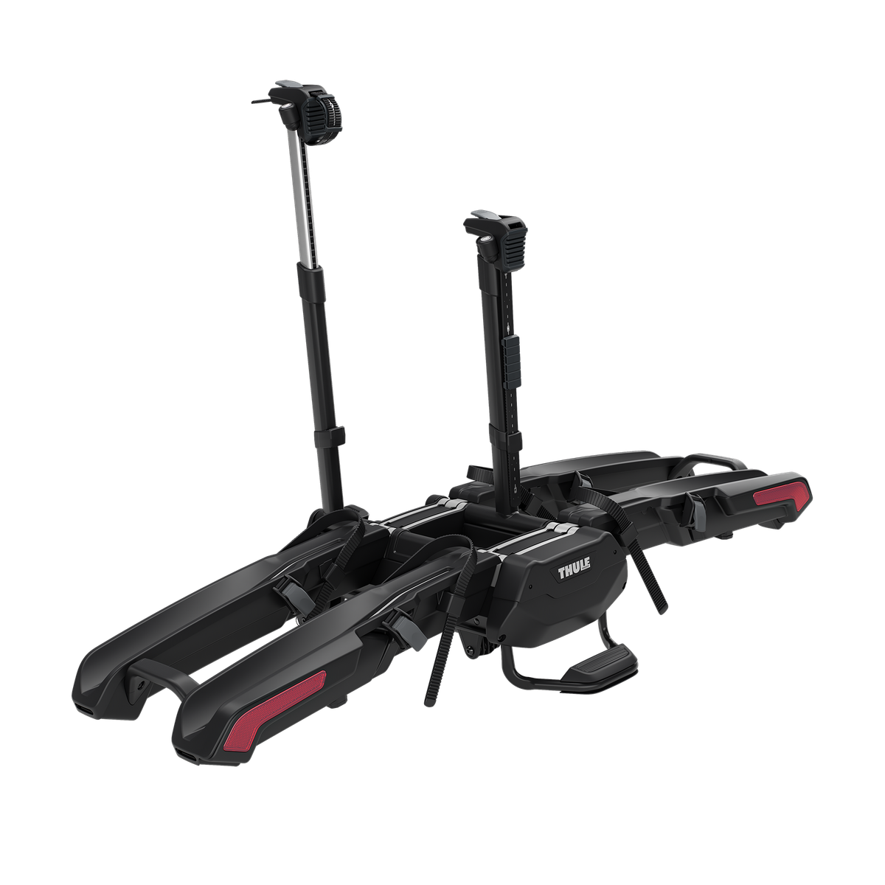
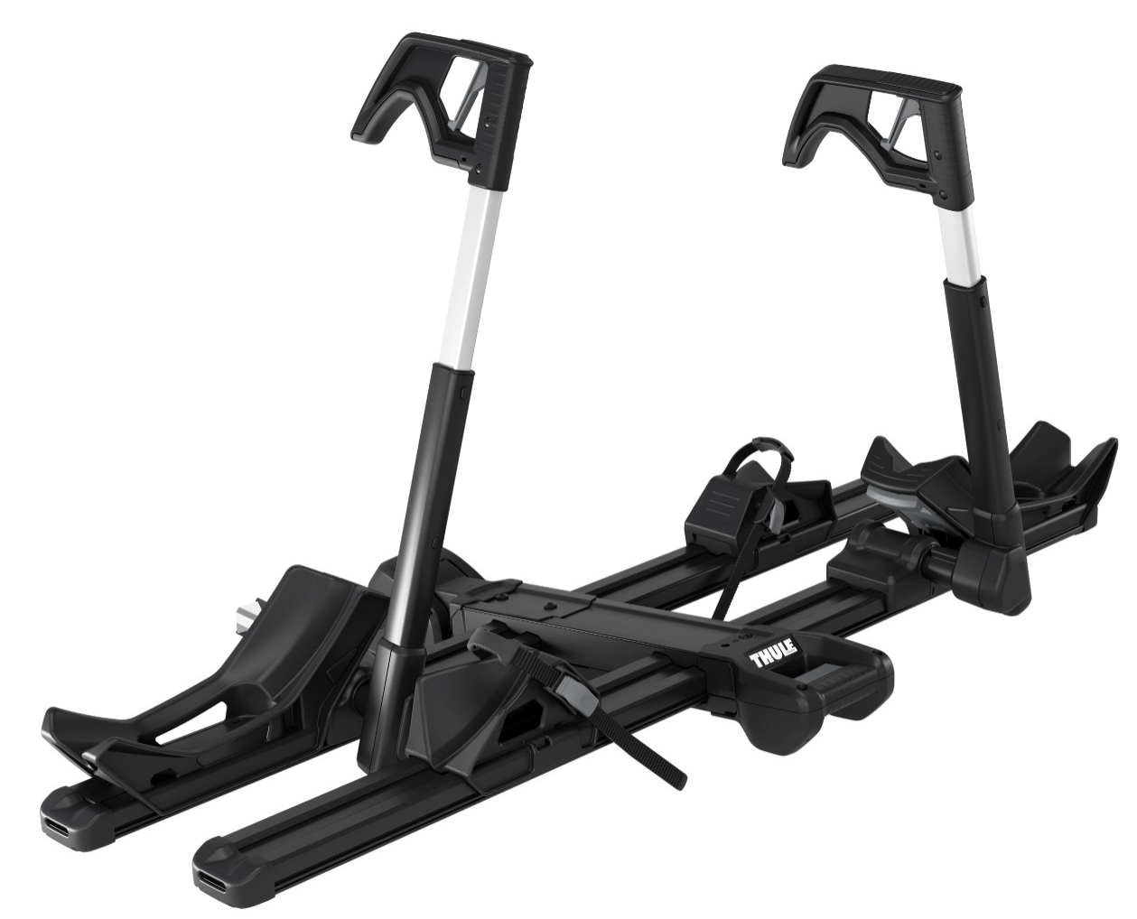
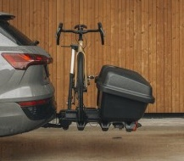
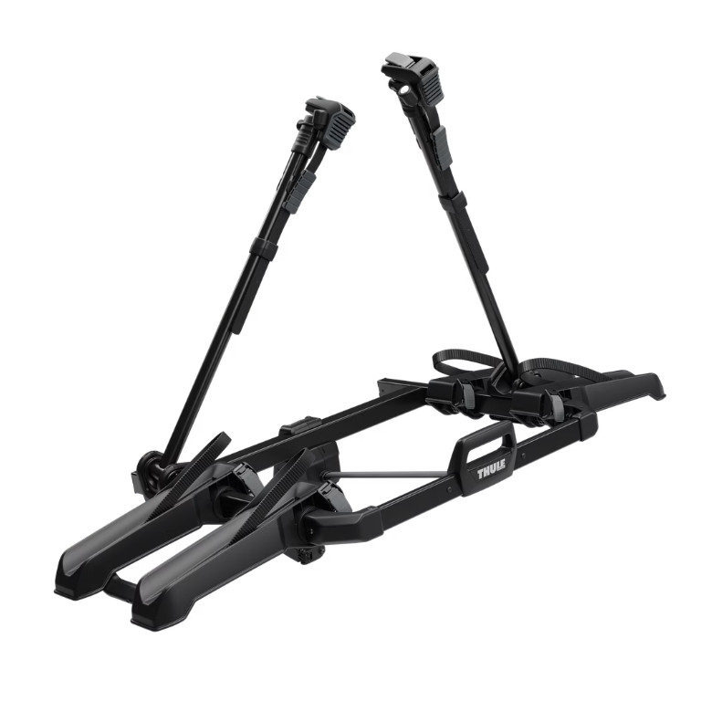
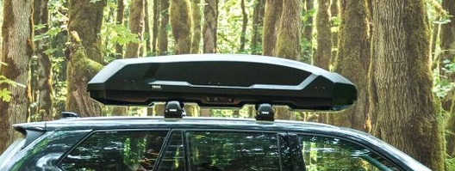
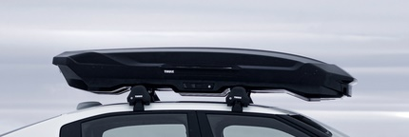
Recent Price Adjustments
YAKIMA VS COMPETITORS
Keeping old tray racks AND new ones makes a crowded premium offering
THULE
Heaviest increases on bike and camp, with more in water, snow, truck, and slightly in crossbars.
New prices effective 6/2, on 117 SKUs, likely no changes until 2026
Big price increases in bike trays, but weak in the lower price points?
Are Arcos/Santu a shot at EXO?
Euro influence via new OutPace
Premium
Old T2 Pro XTR
&
New Verse
Premium eBike
Old EasyFold XT
&
New Epos
$849
$999
$999
$1,099
Santu box + Epos
New mid-priced OutPace
Force 3 is new, but still chasing strong NX sales
Motion 3 is leading, so we need big gains from new CBX

Slide 10
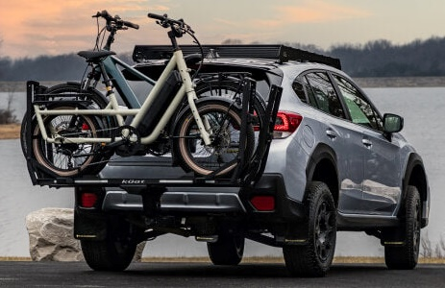
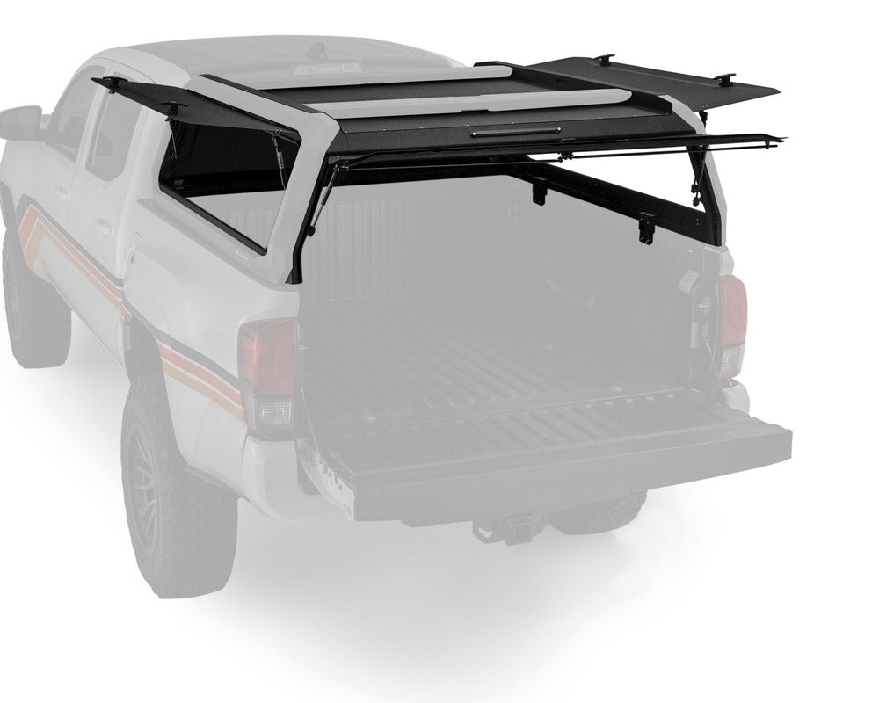
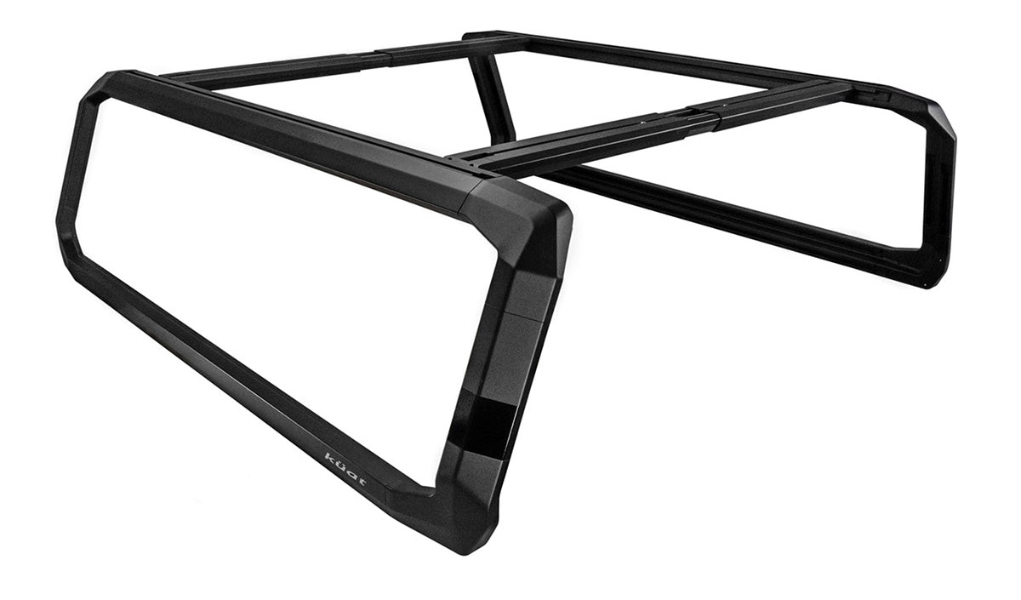
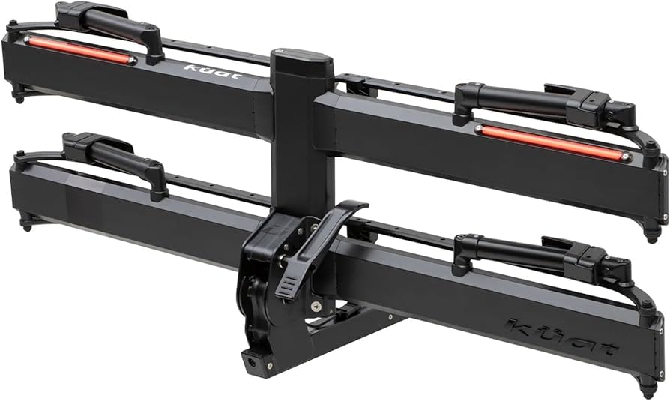
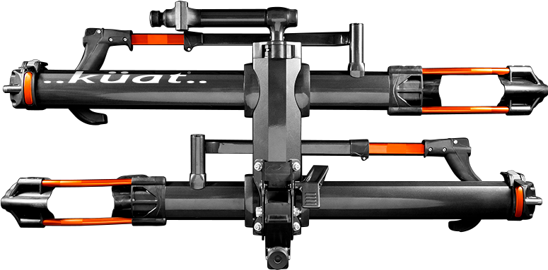
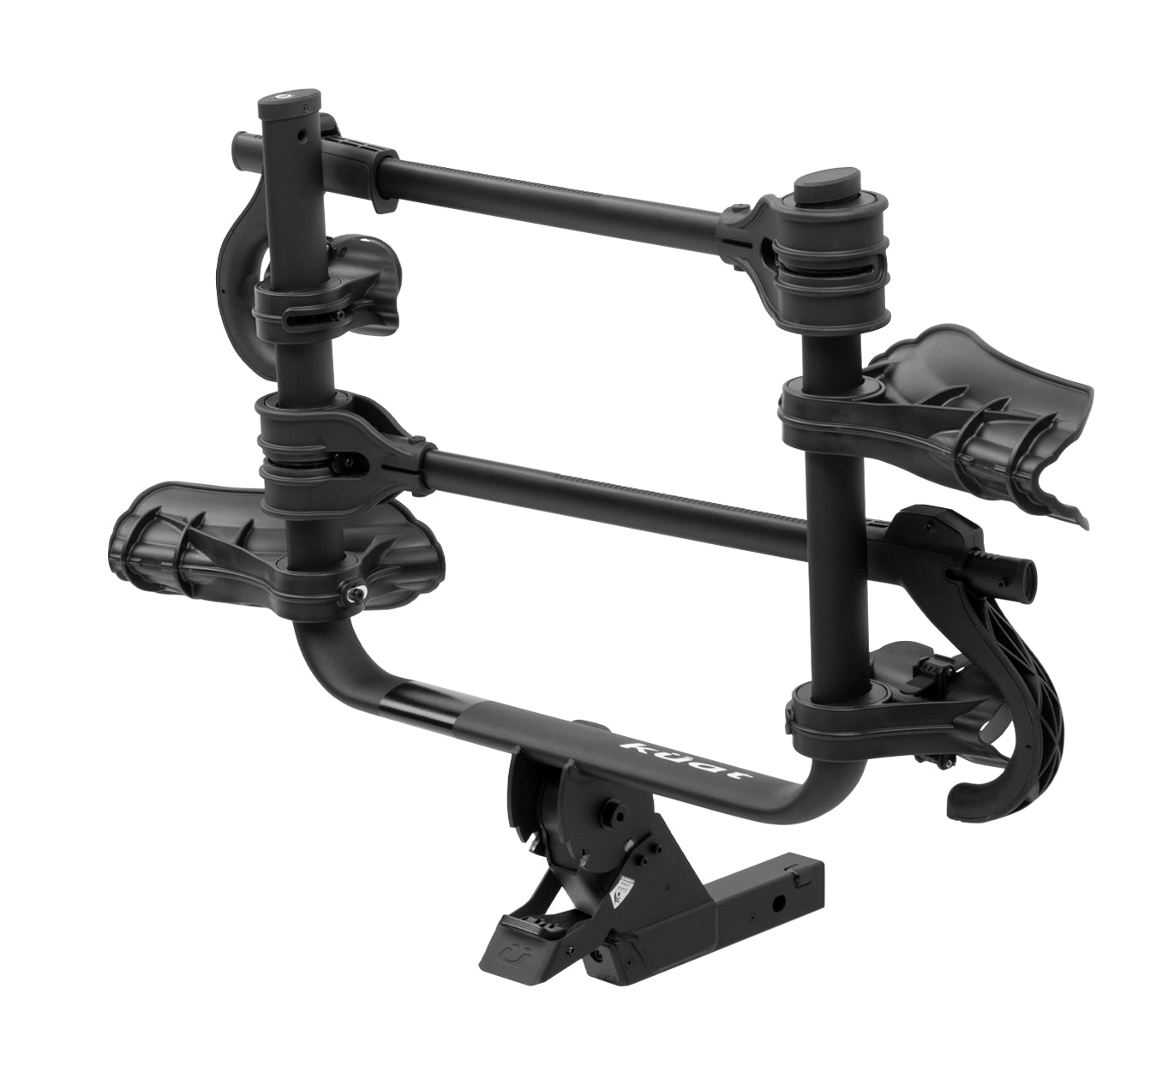
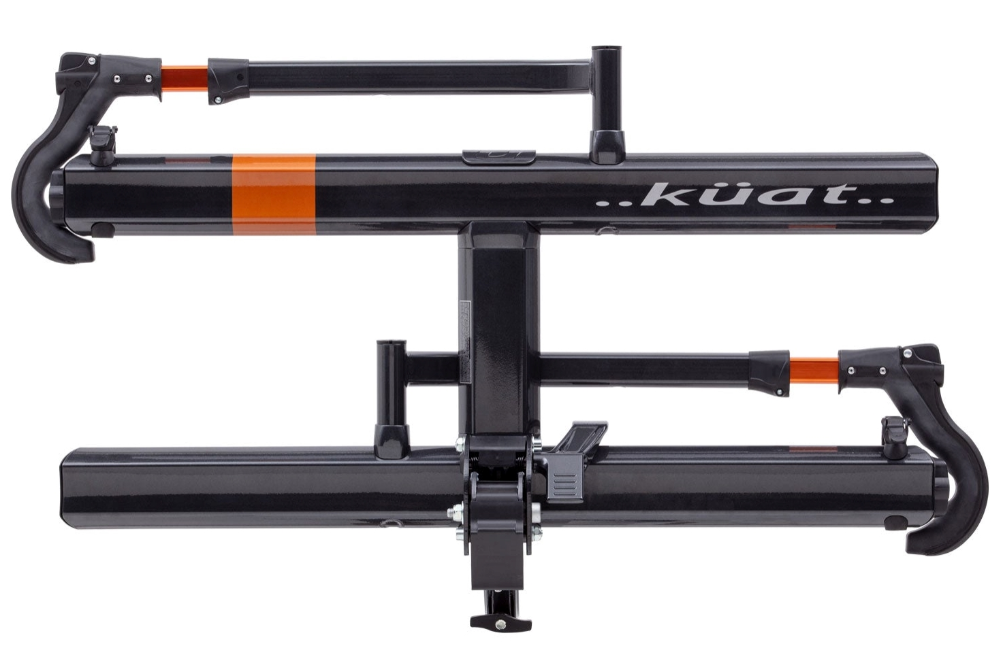
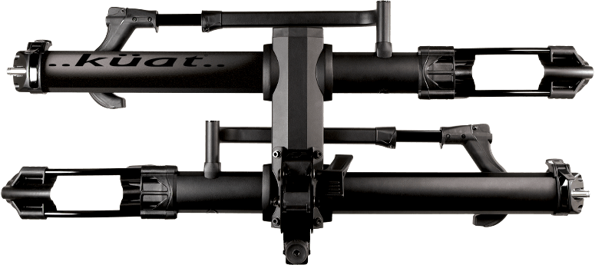
Recent Price Adjustments
YAKIMA VS COMPETITORS
KUAT
Piston ION e-bike rack
Heavily impacted by China tariffs, they finally increased prices broadly, more heavily on premium products.
New prices effective 6/16
Yakima still has price advantages, after increases
Also announced new Piston ION e-bike rack, available in Fall/Winter 2025, $1,289 (…for now)
IBEX truck rack, +$100
NV 2.0 & NV Base 2.0, +$100
Piston Pro/X, +$200
Sherpa 2.0, +$70
Transfer v2, +$60

Slide 11


2 Bike Tray Landscape - US
*Prices shown are after all June price changes
**Mid-2025 price increases shown as (+$)
$1400
Kuat Piston Pro X $1,589 (+$200)
$1300
Kuat Piston Pro $1,298 (+$200)
Kuat Piston ION $1,289 (New)
$1200
RockyMounts AfterParty Swing $1179
$1100
Thule Epos $1,099 (+$100)
$1000
2026 Yakima StepUp Swing $999
Thule Verse $999 (+$50)
Thule EasyFold XT $999 (+$120)
Kuat NV 2.0 $989 (+100)
Yakima OnRamp LX $999 (+$50+$50)
Yakima StageTwo $949 (+$50+$50)
RockyMounts GigaWatt $979
$900
Kuat NV Base 2.0 $898 (+$100)
RockyMounts GuideRail $849
RockyMounts BackStage Swing $799
Thule Pro XTR $849 (+$50)
$800
1Up Equip’d $805
Kuat Sherpa 2.0 $759 (+$70)
Thule Helium $799 (+$50)
$700
2026 Yakima StepUp $699
$600
2026 Yakima HoldUp $599
NEW Thule OutPace $599 (New +$50)
Yakima HoldUp $569 (+$50+$20)
RockyMounts HighNoon FC $599
Kuat Transfer $549 (+$60)
$500
Thule Pro X $549 (-$100 F24)
RockyMounts MonoRail $499
Good Better Best Premium eBike
$550-$600 (+$50) $750-$800 (+$100) $800-$1000 (+$100) >$1200 (+$200)

Slide 12
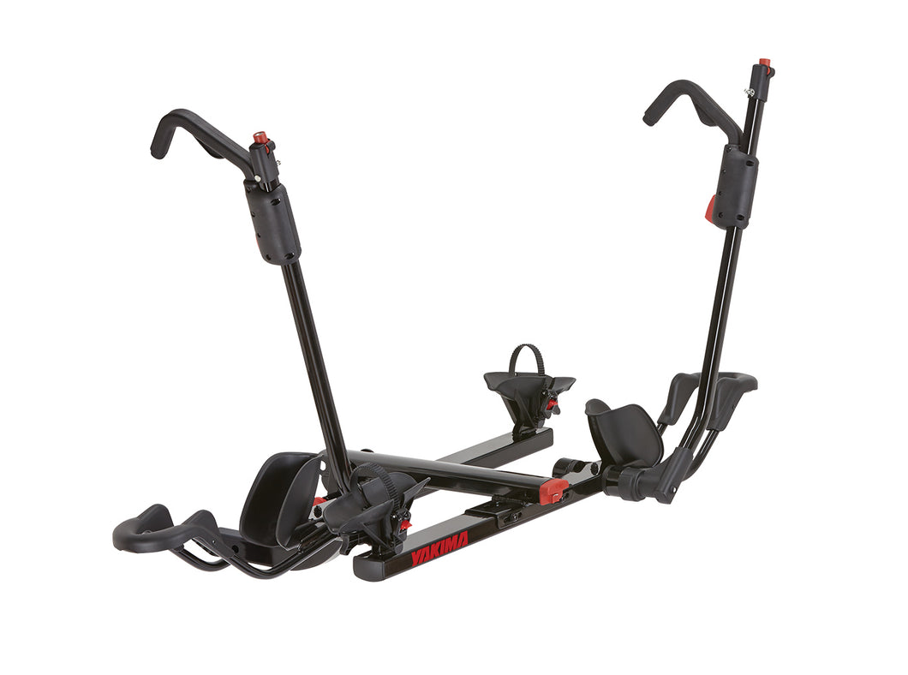
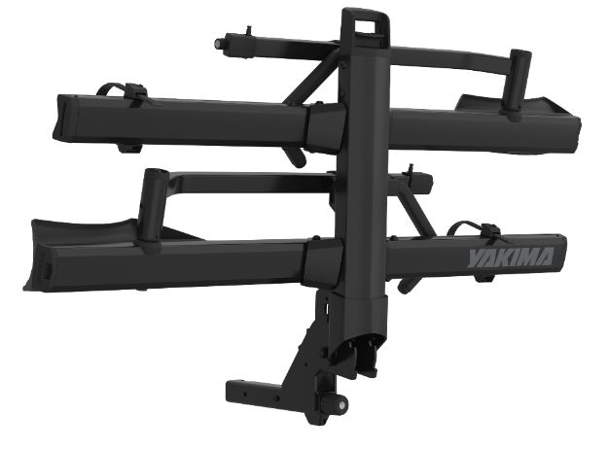
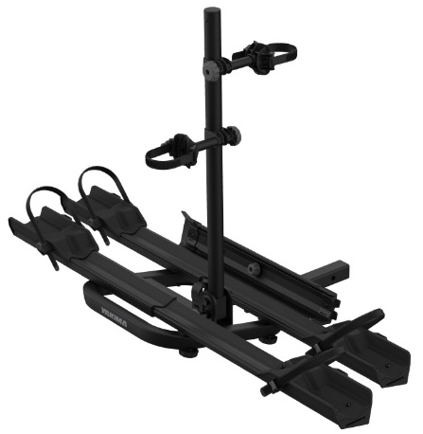

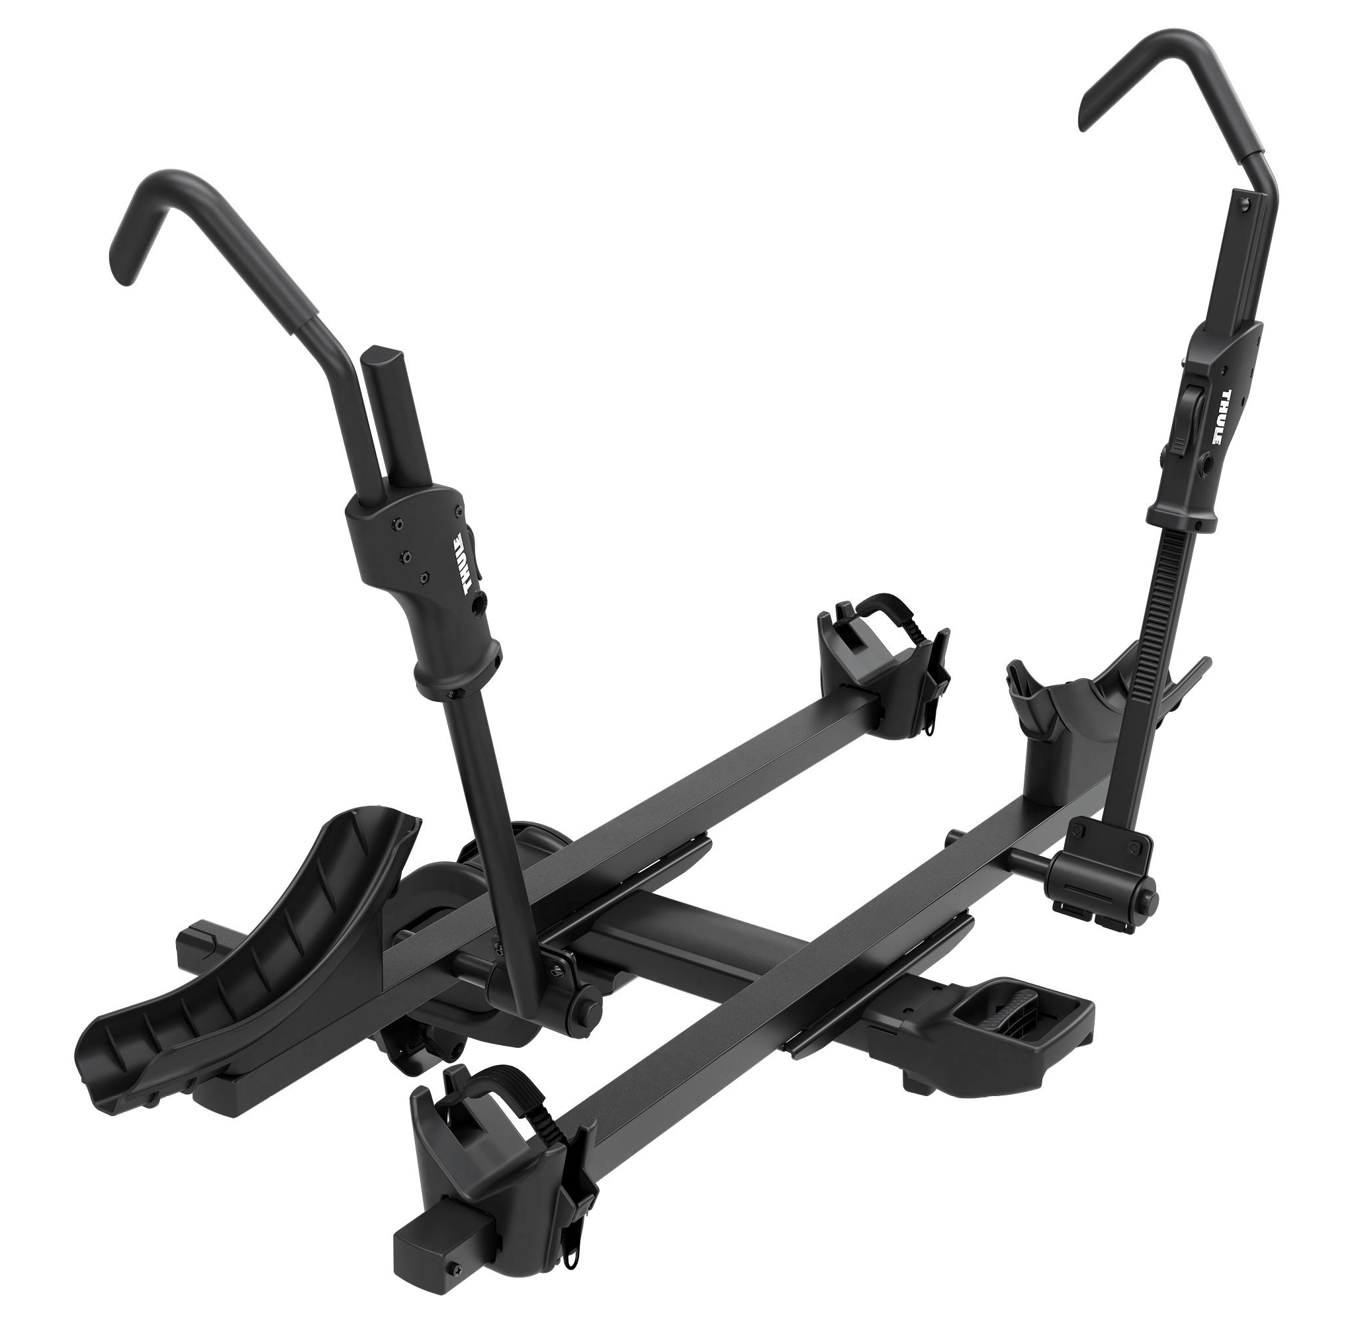
Bike Tray Racks
*Prices shown are after all June price changes
**Mid-2025 price increases shown as (+$)
COMPETITIVE LANDSCAPE
Yakima HoldUp $569 (+$50+$20)
Good
Kuat Transfer $549 (+$60)
Thule Pro X $549 (-$100 F24)
2026 Yakima (NEW) $699
Better
Kuat Sherpa 2.0 $759 (+$70)
Yakima StageTwo $949 (+$50+$50)
Best
Thule Verse $999 (+$50)
Kuat NV 2.0 $989 (+100)
Kuat NV Base 2.0 $898 (+$100)
Thule Pro XTR $849 (+$50)
Yakima OnRamp LX $999 (+$50+$50)
eBike
Thule Epos $1,099 (+$100)
Thule EasyFold XT $999 (+$120)
Thule OutPace $599 (New +$50)
Thule OutPace $599 (+$50)
Thule OutPace $599 (+$50)

Slide 13

Cargo Boxes Landscape - US
*Prices shown are after all June price changes
$2000
Thule Vector Alpine $1999
Thule Vector M $1999
…
Ultra-Premium
$1200
Premium
Low Profile
Thule Motion 3 XXL $1149
Thule Motion 3 XXL Low $1149
CBX XXL $1149
$1100
GrandTour Lo $1099
Thule Motion 3 XL Low $1049
Thule Motion 3 XL $1049
$1000
Thule Motion 3 L $999
Thule Force 3 XXL $999
CBX LG $999
$900
Thule Force 3 XL $899
SkyBox NX XXL $899
Thule Force 3 L $849
$800
Thule Force 3 M $799
SkyBox NX XL $799
Thule Force 3 L Sport $799
SkyBox NX Skinny $779
SkyBox NX LG $749
Volume Driver
$700
RocketBox Pro 14 $699
Thule Pulse L $699
Thule Pulse Alpine $649
$600
Thule Pulse M $649
DeepSpace 10 $629
Price Point
$500
MD-LG
MD
LG
XL
XXL

Slide 14
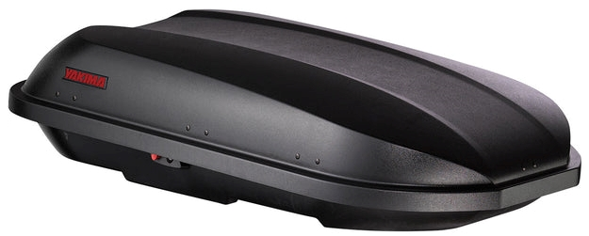
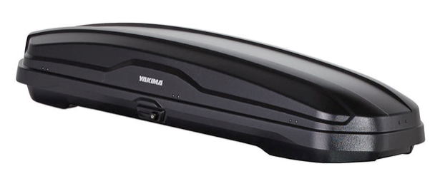
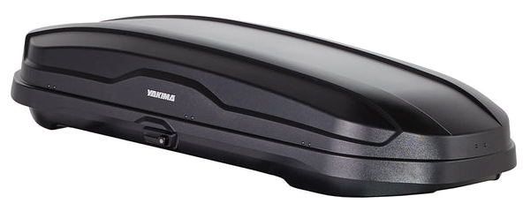
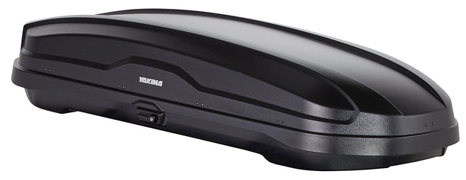
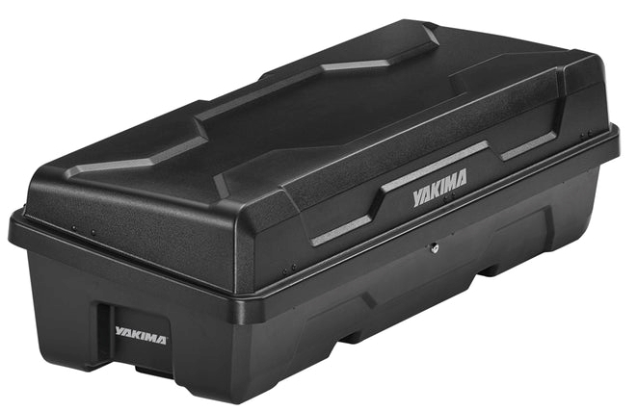
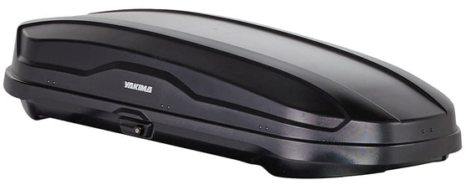
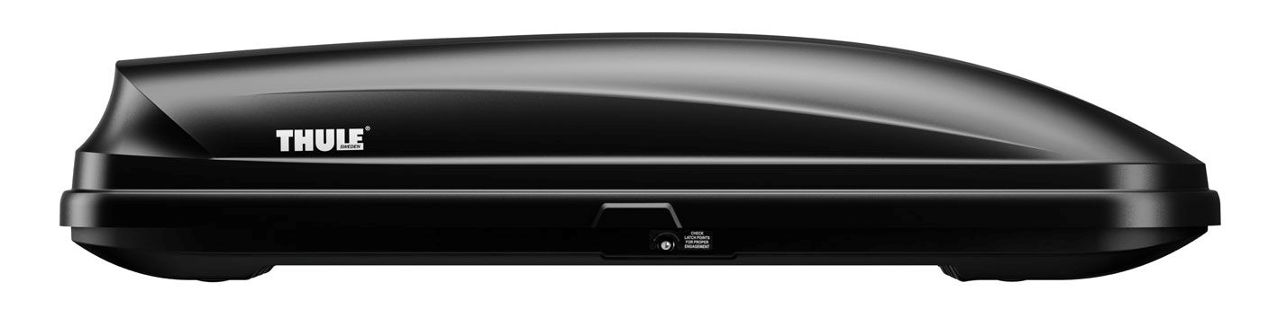



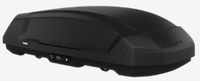
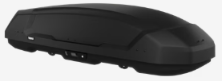
Cargo Boxes
*Prices shown are after all June price changes
**Mid-2025 price increases shown as (+$)
COMPETITIVE LANDSCAPE
RocketBox Pro 14 $699 (+$100)
Price Point & Misc.
Thule Pulse L $699 (+$50)
SkyBox NX Skinny $779 (+$0) | SkyBox NX LG $749 (+$0) | SkyBox NX XL $799 (+$0) | SkyBox NX XXL $899 (+$0)
MD/Skinny | LG | XL | XXL
Thule Force 3 M $799 (NEW+$0) | Thule Force 3 L $849 (NEW+$0) | Thule Force 3 XL $899 (NEW+$0) | Thule Force 3 XXL $999 (NEW+$0)
Thule Force 3 L Sport $799 (NEW+$0)

Slide 15
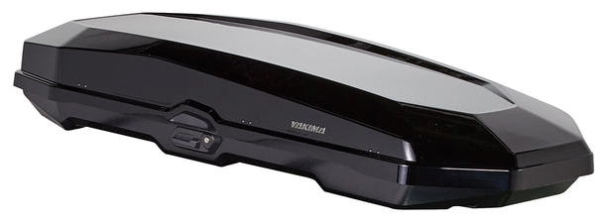
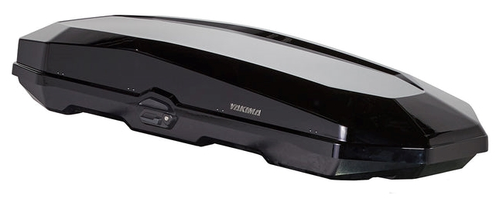
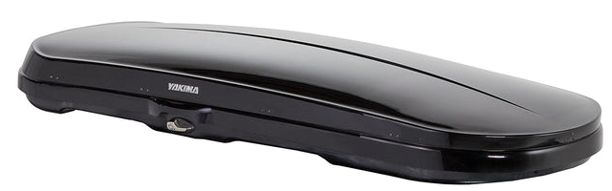
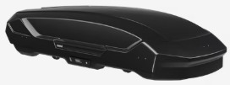




Cargo Boxes
*Prices shown are after all June price changes
**Mid-2025 price increases shown as (+$)
COMPETITIVE LANDSCAPE
CBX LG $999 (+$100) | -- | CBX XXL $1149 (+$100)
LG | XL | XXL
Thule Motion 3 L $999 (+$0) | Thule Motion 3 XL $1049 (+$0) | Thule Motion 3 XXL $1149 (+$0)
GrandTour Lo $1099 (+$100)
Low Profile
Thule Motion 3 XXL Low $1149 (+$0)
Thule Motion 3 XL Low $1049 (+$0)

Slide 16
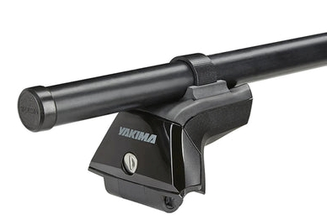
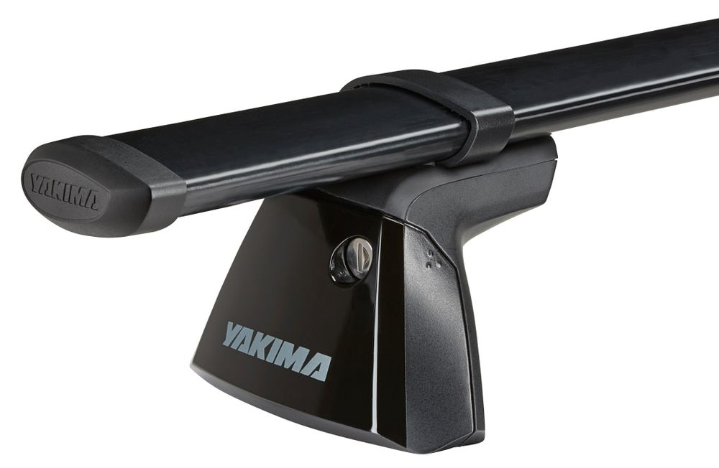
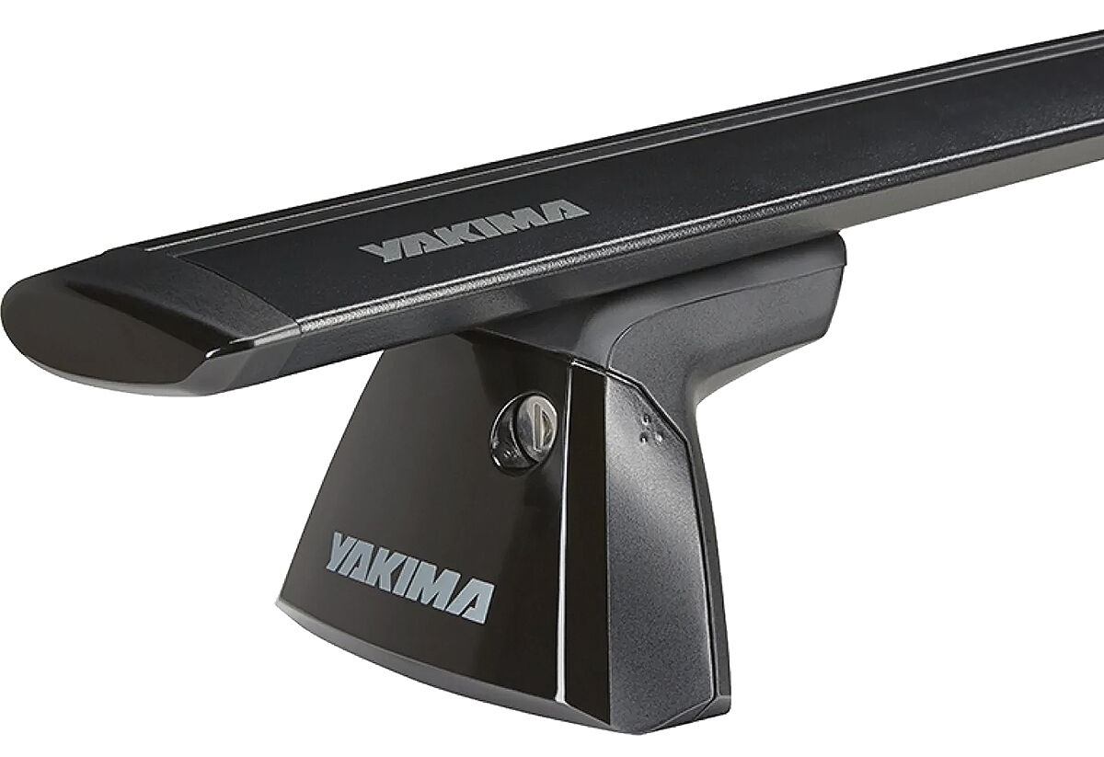
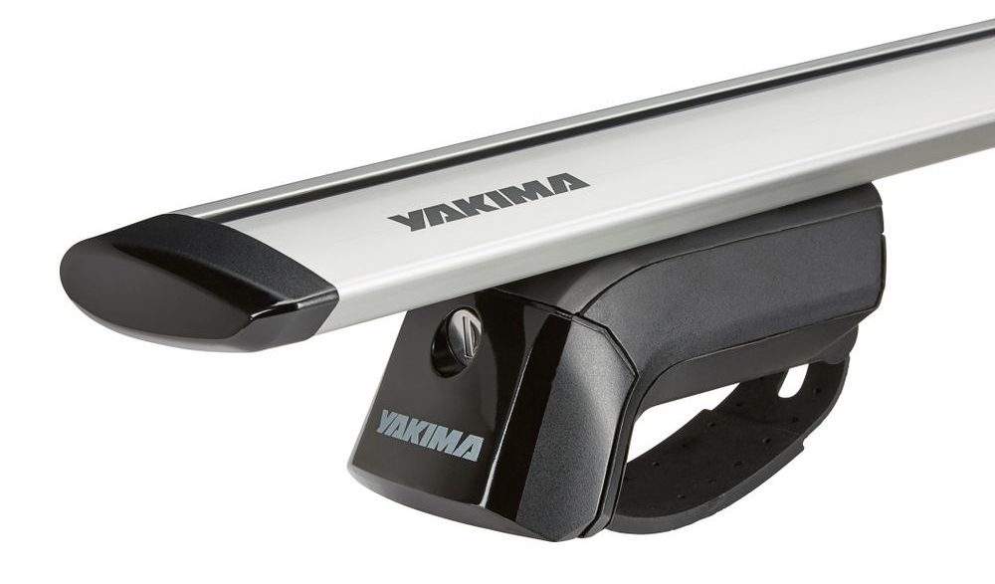
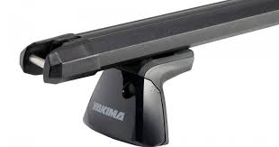
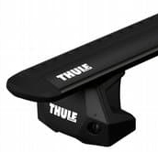
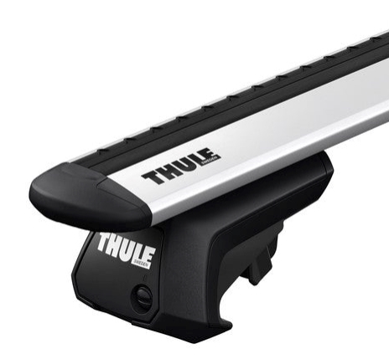
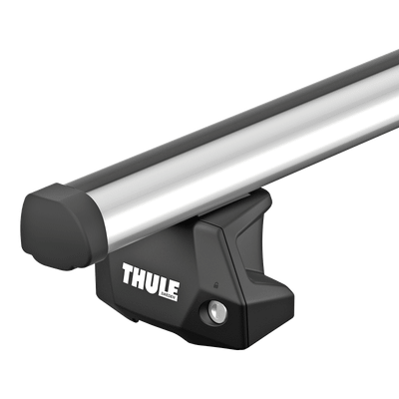
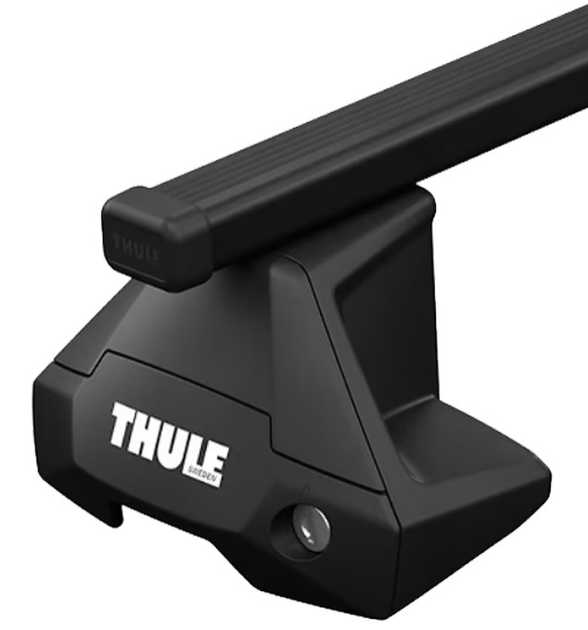
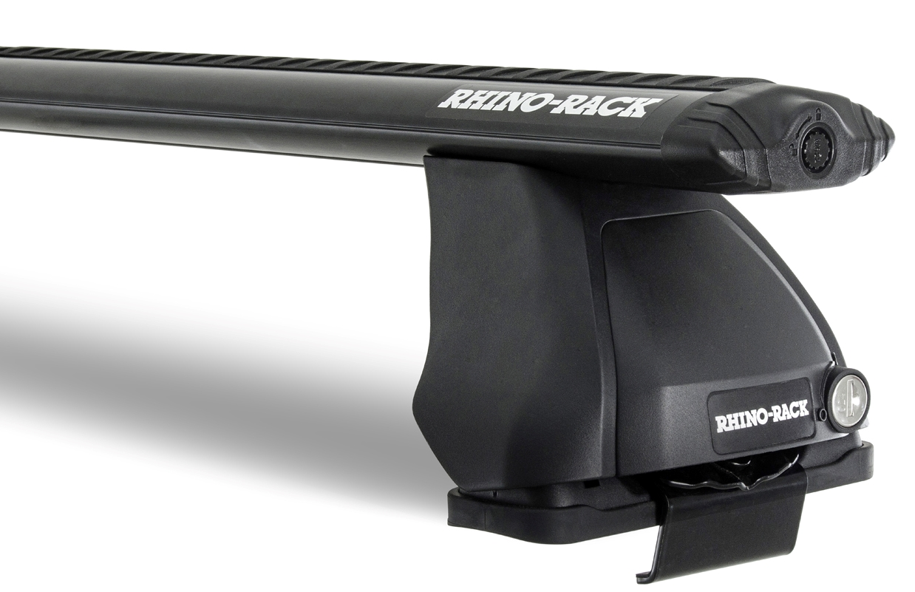
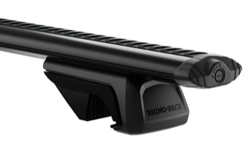
Roof Rack Systems
*Prices shown are after all June price changes
**Mid-2025 price increases shown as (+$)
COMPETITIVE LANDSCAPE
Round Bar System Bar+Tower+Clip/LP $569 (+$20)
Vehicle kit required
Thule Square Bar Evo $580 (+$10)
--
CoreBar System Bar+Tower+Clip/LP $629 (+$10)
Vehicle kit required
--
--
JetStream Bar System Bar+Tower+Clip/LP $689 (+$0) | JetStream System Bar+TimberLine $509 (+$0)
Vehicle kit required | No kit required
Thule WingBar Evo $680 (+$10) | Thule WingBar Evo $499 (+$10)
Rhino Vortex Bar $605 | Rhino Sportz Bar $540
HD Bar System $768 (+$0)
Vehicle kit required
Thule ProBar Evo $659 (+$0)
--

Slide 17
Recent Price Adjustments
*Prices shown are after all June price changes
**Mid-2025 price increases shown as (+$)
YAKIMA VS COMPETITORS
RidgeBack 4 $459 (+$50+$30)
Bike Mast
Thule Apex XT 4 $499 (+$50)
FullSwing $699 (+$50)
Bike Mast Swing
Thule Apex XT Swing $699 (+$0)
HighRoad $349 (+$30+$20)
Bike Roof
Thule UpRide $349 (+$50)
FrontLoader $249 (+$50)
Bike Roof
RockyMounts BrassKnuckles $249 (+$0)
OverNOut 270 XL $1,099 (+$100)
Camp
Rhino BatWing 270 $1,399
JayLow $239 (+$0)
Water
Thule HullAPort XTR $249 (+$0)
Malone Downloader $199
FatCat EVO 6 $399 (+$50)
Snow
Thule Snowpack 6 $399 (+$0)
Kuat Grip 6 $498
SkyRise SL $2,199 (+$400)
Camp
Thule Approach S $2,299 (+$300)
Roofnest Meadowlark XL $1,999
SkyRise HD $2,899 (+$400)
Camp
Thule Approach M $2,699 (+$200)
iKamper X-Cover 3.0 $2,699
SkyPeak HD $3,999 (+$1,000)
Camp
Thule Basin Wedge $2,999 (+$0)
Roofnest Falcon 3 EVO $3,499

Slide 18
Market Update
…AT LEAST FOR THIS WEEK
The world changes, and we must be agile.
Fast and frequent news
We are, and will be nimble
Market Pricing has shifted (by all)
We are still set up to win

Slide 19
NEW PRODUCT
SPRING 2026

Slide 20
Feeling down?
Frustrated? Discouraged? Disappointed?
Yakima has something that can help.

Slide 21
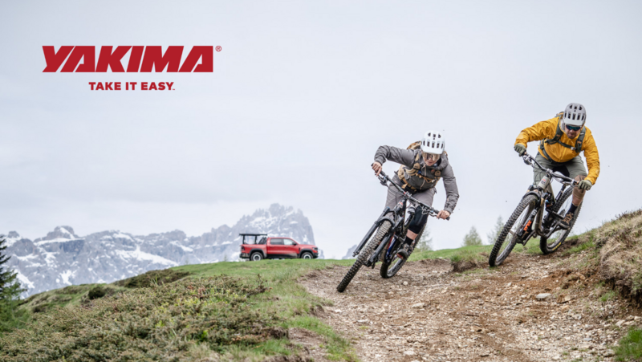
BIKE THERAPY
with Yakima

Slide 22





BIKE THERAPY
The complete path to wellness
HangTight
Vertical Orientation
New Sp26
New Sp26
HoldUp
StepUp
StageTwo
Electric Tendencies
OnRamp LX
& Swing Version

Slide 23







2026 Only
ALTERNATIVE PATHWAYS
Special Treatments
OverHaul HD
Shadow Edition
New Sp26
Supplemental Approach
2.5” to 2” Adapter
FlipFlop
Hitch BookMark
Adjustable Awning Bracket
OpenRange Deluxe
RuggedLine HD
Tacoma 2024+

Slide 24

Yakima Sp26 Product
TRANSITION PLANNER
23 SKU’s total
PRIMARY LAUNCH STORIES
BIKE
TRUCK
SUPPORTING PRODUCTS
HITCH ACCESSORIES
ROOF RACKS
CAMP

Slide 25


2026 Truck Product Launch

Slide 26







OverHaul Shadow Edition
TRUCK
THE OBJECTIVE
Call To Attention
Yakima Brand
Top Truck Rack
Reaching Out
Overland
Off-Road
Exclusive Launch
Limited run
Collectable
New Accessory
Bonus extras
All-in-one
OnX
Collaboration

Slide 27



OverHaul Shadow Edition
TRUCK
WHAT’S EXCLUSIVE
Adjustable Molle Pannel
2x Panels Included
40” – 54” Crossbar spreads
80lb load limit
Laser cut Shadow Edition logo
Limited Edition Badging
Shadow edition Logo + Larger Yakima logo
Serialized plates w/logo and 01/1000
Everything In One Box
2 SKU’s, with Medium or Large crossbars
Unique packaging with premium experience
Limited Run of 1000
MSRP - $2199
Surprise & Delight
1-year free subscription to OnX Offroad
Included tools come packaged in tool roll
Room for more tools
Has Yakima and OnX logos
*Adventure Therapeutics Certified

Slide 28




Adjustable Awning Bracket
BASE CAMP
AWNING ACCESSORY
Need some space? Adjustable awning bracket lets you raise or lower your shade to accommodate more on your bars
Compatible with all Yakima awnings
Provides 95mm of vertical adjustment
T-slot attachment hardware included
MSRP - $99
Yakima Products, Inc. Confidential
Notes:
$99/$59 pricing 5.14

Slide 29


OpenRange Deluxe
EXO SYSTEM
EXO SYSTEM CAMP KITCHEN BUNDLE
Same great outdoor camp-kitchen with a new bundle offering. This new kit includes both the Wood and Metal Side Tables and the Leg Kit.
Compatible w/EXO SwingBase or EXO TopShelf
Durable rotomolded shell with a rubber door seal
Fold down door can be used as a prep surface
Included utensil drawer, external backboard organizer, side tables, sink, cutting board & legs
85 L/90qt of internal storage space
Includes SKS locking latches to secure your gear
MSRP - $1,199
Yakima Products, Inc. Confidential
Notes:
$749 for Basic, $229 Leg Kit, $199 Tables Each = $1,376
Pairs well with MOD for a great Tailgate setup

Slide 30

2026 Bike Product Launch

Slide 31





BIKE
OnRamp LX’s eBike
Competitive Wins
Yakima OnRamp | Thule Epos | Thule EasyFold
2 Bike - $999 (+$100) | 2 Bike - $1099 (+$100) | 2 Bike - $999 (+$120)
Up to 80lb/36kg per bike RV & Acc Full Rated | Up to 75lbs/34kg RV Rated | Up to 65lbs/29.5kg RV Rated
Up to 54”/1372mm wheelbase, Up to 29”, up to 5” wide | Up to 53”/135cm Up to 29”, up to 3.2” wide Up to 5” wide with Fat Kit | Up to 51”/130cm Up to 29”, up to 3” wide Up to 4.7” wide with Fat Kit
Ramp Included, 3 Position Tilt, Offset Trays. Tailgate Clearance, Light & Plate Kit, Rack Weight–53lbs/ 24kg | Single Arm Frame grab, Light & Plate style, Repair Holder, Transport Wheels Rack Weight–38lbs/17kg | Rear Hoop Frame grab, Ramp included, Light & Plate style, Repair Holder, Transport Wheels Rack Weight–45lbs/20.5kg
Carries Heaviest Bikes
Fully Rated RV & Swing
Adjustable XX-long Wheelbase Cargo Bikes
Fits X-fat Tires Out Of The Box
Fits All Wheel Sizes
Fast Bike Fit, Loading, Unloading
Stadium Rise & Tailgate Fit
Lightweight & Small For Storage
Flat To Car Tilt Position
RampUp Included On Rack
Yakima Accessory Compatibility
Yakima Testing & Standards
Yakima Products, Inc. Confidential

Slide 32


BIKE
StageTwo’s Best
Competitive Wins
Yakima StageTwo | Thule Verse | Kuat NV 2.0
2 - $949 (+$100) | 2 Bike - $999 (+$50) | 2 Bike - $989 (+$100)
Up to 70lb/32kg per bike RV & Acc Full Rated | Up to 60lbs/27kg RV Rated, no Trailers | Up to 60lbs/27kg RV Rated
30-52”/1372mm wheelbase, 16 – 29”, up to 5” wide | Up to 53”/135cm Up to 29”, up to 5” wide | Up to 50”/127cm Up to 29”, 20-24” w/ Adapter Up to 5” wide with Fat Kit
Remote Tilt, Offset Trays. Tailgate Clearance, Easy Hitch Install, +2Add-On, Light & Plate Kit, Rack Weight–63lbs/ 27.5kg | +2Add-On, Light & Plate Kit, Repair Holder, Transport Wheels Rack Weight–58lbs/26kg | Long time industry leader, was originally very disruptive. But it has aged. +1 or +2, and Ramp Rack Weight–56lbs/25.4kg
Carries Heaviest eBikes 2 & +2
Fully Rated RV & Swing
Fits X-long Wheelbase MTB
Fits X-fat Tires
Fits Lil Kids To 29er Wheel Sizes
Fast Bike Fit, Loading, Unloading
Stadium Rise & Tailgate Fit
RampUp Compatibility With Storage
Yakima Accessory Compatibility
Yakima Testing & Standards
Yakima Products, Inc. Confidential

Slide 33

2026 StepUp Bike Platform Rack
BIKE

Slide 34




BIKE
StepUp
Consumer Mindsets
Deeply Held Motivators, Hindrances. & Attitudes
Motivated to ride for their physical and mental health. Some are competitive, others are there for a good time, but all are looking to share their rides with others.
They can be Hindered by total cost of the activity, places to ride being too far away, or simply too hard to find the time in a busy life.
Their Attitudes lead them to want up-to-date name brand gear as their identity is being a cyclist, from a brand they trust, and their friends approve of.
Urban Athlete
Athletic, Competitive, Bustling/Absorbed Life
Aspirational Core
Performance Seeking, Aspirational, Intermittent
OutDoor Native
Established, Highly Involved, Adventure Driven
DEMOGRAPHICS
20% of consumers & 33% of market spend,
61% between 18-34, 39% F / 61% M, 60% With Kids in the House, 33%, Higher Income
23% Hispanic, 8% Asian
Live in City Center
MOTIVATORS
Competing against others
Connecting with others
Thrill seeking
Improve overall mental and physical health
Be social and involved
HINDRANCES
Lack of free time
Not feeling safe while riding
Places to ride are too far away
Level of physical comfort on a bike
Intimidated to start of join
ATTITUDES
Grew up in team sports
Very busy and struggle to keep up activity level
Want to know how products were made
Stressed and stretched
Involved and social
Stand out, rather than fit in
Space solutions
Like gear/products
GEAR NEEDS
Technical, stylish and specific-use gear. They like versatile and proven industry brands that are well known and long standing. Tend to feel unspoken to by these brands marketing messages
DEMOGRAPHICS
14% of consumers & 14% of outdoor market spend.
51% between 18-34, 43% F / 57% M, 45% With Kids in the House
59% Caucasian, 8% Asian
No locationality skew.
MOTIVATORS
Improve overall mental and physical health
Have fun and great experiences
Be social and involved
HINDRANCES
Total cost of bike, accessories and clothing
Places to ride are too far away
ATTITUDES
Focused on few specific activities
Venture away from home for outdoor activities
Value activity-specific gear
Want style of function
Less tradition
May be more gear oriented to impress
Take advantage of shares or rentals
GEAR NEEDS
Quality specific-use gear, but not top end. They like brands that are used by friends or family and long standing in industry. They shop at sporting good chains and specialty chains.
DEMOGRAPHICS
12% of consumers & 16% of outdoor market spend,
26% between 35-44, 45% F / 55% M, 45% With Kids in the House
61% Caucasian, 20% Hispanic
No significant skew for locationality
MOTIVATORS
Improve overall mental and physical health
Have fun and great experiences
Improve ability and skillset
HINDRANCES
For some, the lack of free time, most figure it out
ATTITUDES
Challenge themselves, but don’t care about being the best
Get kids involved in cycling
Value experiences
See themselves riding into old age
Social and involved
Strong stance of health
GEAR NEEDS
High quality gear with versatile, functional design. They like brands with a mission beyond margin and manage informative websites on the products and technology. They read/watch positive reviews on brands and products before buying. They shop at a mix of specialty instore and online, along with mass online.
Yakima Products, Inc. Confidential
Notes:
StepUp enables riders to have quick access to a great experience, with its thoughtful features from a brand that brings trust and value.

Slide 35

2026 StepUp
BIKE
Streamlined, heavy duty design that is fully featured for a core cyclist's needs; easy to install, load bikes to get riders on their way. But also, everyday access to the vehicle for gear or groceries
with integrated swing and remote tilt features.
Notes:
StepUp enables riders to have quick access to a great experience, with its thoughtful features from a brand that brings trust and value.

Slide 36




eBike StrongArm
RampUp V-Trays & Storage
Notes:
Easy & quick

Slide 37



Swing Away Access
Dual Remote Tilt Access
Notes:
Easy Access to everyday life

Slide 38





Stadium Streamlined
Secure Tooled Wedge
Notes:
Thoughtful brand – quick benefits

Slide 39


SKS Bike & HitchLock
Integrated Lock Loop
Notes:
Safety

Slide 40



Dual Tray Positions
Dual Wheelbase Position
Notes:
Fit for all the friends or family, +/- 40” WB

Slide 41



BIKE
StepUp Swing
Competitive Wins
Yakima StepUp Swing | Rocky Mounts BackStage | Thule Verse | Kuat NV 2.0
2 - $699 2 Swing - $999 | $799 2 bike (+$30) | 2 Bike - $999 (+$50) | 2 Bike - $989 (+$100)
Up 65lbs/29.5kg per Bike, RV/ BackSwing /StraightShot Derated | up to 60lbs/27kg per bike | Up to 60lbs/27kg RV Rated, no Trailers | Up to 60lbs/27kg RV Rated
32-52” wheelbase, 16 - 29” wheels, and up to 4.5” tires | 36-50” Wheelbase 20” to 29”, up to 3” wide | Up to 53”/135cm Up to 29”, up to 5” wide | Up to 50”/127cm Up to 29”, 20-24” w/ Adapter Up to 5” wide with Fat Kit
Remote Tilt, Offset Trays. Tailgate Clearance, Swing Access, Easy Hitch Install Rack Weight–48bs/22kg & 62lbs/28kg | Integrated Swing Model On Market, Strong Brand in Rack Specialty and Non-Circana Channels Rack Weight–60lbs/27kg | +2Add-On, Light & Plate Kit, Repair Holder, Transport Wheels Rack Weight–58lbs/26kg | Long time industry leader, was originally very disruptive. But it has aged. Add On for 1 or 2, and Ramp Rack Weight–56lbs/25.4kg
Carries Heaviest eBikes
Integrated, Fully Rated Swing
Fits X-long Wheelbase MTB
Fits Fat Tires
Fits Lil Kids To 29er Wheel Sizes
Fast Bike Fit, Loading, Unloading
Stadium Rise & Tailgate Fit
RampUp Compatibility & Storage
Yakima Accessory Compatibility
Yakima Testing & Standards
Yakima Products, Inc. Confidential

Slide 42




BIKE
StepUp Better
Competitive Wins
Yakima StepUp | Thule Pro X | Kuat Sherpa | Rocky Mounts HighNoon FC
2 - $699 2 Swing - $999 | T2 Pro X 2 - $549 (-$100) T2 Pro X +2 - $399 (-$120) | Sherpa 2 2“/1.25” - $759 (+$70) | HighNoon FC 2 - $599 HighNoon FC Solo - $399
Up to 65lbs/29.5kg per Bike, RV/ BackSwing/ StraightShot Derated | Up to 50lbs/22.5kg per bike | 40lbs/18kg per bike | up to 60lbs/27kg per bike
32-52” wheelbase, 16 - 29” wheels, and up to 4.5” tires | Up to 49” wheelbase, 20 - 29” wheels, and up to 3” tires. Fat bike kit sold separately | Up to 47” wheelbase, 26-29”, up to 3" wide 20-24" Adaptor sold separate | 36-52” wheelbase, 20 – 29”, up to 5” wide
Remote Tilt, Offset Trays. Tailgate Clearance, Quick Hitch Install Rack Weight–48bs/22kg & 62lbs/28kg | Remote Tilt, Adj. Offset Trays Rack Weight–50lbs/22.5kg | Lightweight, Quick Hitch Install Rack Weight–32lbs/14.5kg | Awkward Fender Compatibility Rack Weight–39lbs/18kg
Carries Heaviest eBikes
Dual Remote Tilt Release
Fits X-long Wheelbase MTB
Fits Fat Tires
Fits Lil Kids To 29er Wheel Sizes
Fast Bike Fit, Loading, Unloading
Stadium Rise & Tailgate Fit
RampUp Compatibility With Storage
Yakima Accessory Compatibility
Yakima Testing & Standards
Yakima Products, Inc. Confidential

Slide 43

2026 HoldUp Bike Platform Rack
BIKE

Slide 44


BIKE
HoldUp
Consumer Mindsets
Deeply Held Motivators, Hindrances. & Attitudes
Motivated to ride for their physical and mental health. All are doing it for a good time, most looking to share their rides with others.
They can be Hindered by total cost of the activity and a lack of free time or access to trails or open roads.
Their Attitudes lead them to want quality gear as they see themselves riding for the indefinite future, but at a good price.
Athleisurist
Low Intensity, Enjoyment, Emotionally Driven
Aspirational Core
Performance Seeking, Aspirational, Intermittent
OutDoor Native
Established, Highly Involved, Adventure Driven
DEMOGRAPHICS
20% of consumers & 12% of outdoor market spend,
60% between 45-65, 59% F / 41% M, 34% With Kids in the House
75% Caucasian
Lives in small town or rural areas
MOTIVATORS
Improve overall mental and physical health
Have fun and great experiences
HINDRANCES
Lack of free time
Total cost of bike, accessories and clothing
Level of energy, fitness
ATTITUDES
Value experiences
Strive to be well rounded
Plan on being active into old age
Looking to disconnect from tech
Less social
Not looking to stand out
On track with health
GEAR NEEDS
Comfortable, and versatile use gear. Less concerned with style or the opinions of others. They shop at Sporting Goods Chains and Mass Stores, but will rent or demo equipment as well.
DEMOGRAPHICS
14% of consumers & 14% of outdoor market spend.
51% between 18-34, 43% F / 57% M, 45% With Kids in the House
59% Caucasian, 8% Asian
No locationality skew.
MOTIVATORS
Improve overall mental and physical health
Have fun and great experiences
Be social and involved
HINDRANCES
Total cost of bike, accessories and clothing
Places to ride are too far away
ATTITUDES
Focused on few specific activities
Venture away from home for outdoor activities
Value activity-specific gear
Want style of function
Less tradition
May be more gear oriented to impress
Take advantage of shares or rentals
GEAR NEEDS
Quality specific-use gear, but not top end. They like brands that are used by friends or family and long standing in industry. They shop at sporting good chains and specialty chains.
DEMOGRAPHICS
12% of consumers & 16% of outdoor market spend,
26% between 35-44, 45% F / 55% M, 45% With Kids in the House
61% Caucasian, 20% Hispanic
No significant skew for locationality
MOTIVATORS
Improve overall mental and physical health
Have fun and great experiences
Improve ability and skillset
HINDRANCES
For some, the lack of free time, most figure it out
ATTITUDES
Challenge themselves, but don’t care about being the best
Get kids involved in cycling
Value experiences
See themselves riding into old age
Social and involved
Strong stance of health
GEAR NEEDS
High quality gear with versatile, functional design. They like brands with a mission beyond margin and manage informative websites on the products and technology. They read/watch positive reviews on brands and products before buying. They shop at a mix of specialty instore and online, along with mass online.
Yakima Products, Inc. Confidential
Notes:
Athleisurist replaces Urban Athlete
HoldUp enables riders to have easy experience to ride, even with the whole family. But out of the way when stored longer term, while also smaller impact to their wallet.

Slide 45

2026 HoldUp
BIKE
Lightweight, compact, and user-friendly, the HoldUp is designed for recreational riders who want to grab their bikes and go. When reliability matters, the HoldUp delivers as your dependable workhorse.
Notes:
HoldUp enables riders to have easy experience to ride, even with the whole family. But out of the way when stored longer term, while also smaller impact to their wallet.

Slide 46


EVOArm
Bottle Opener
Notes:
Quick & Easy – Great Experience

Slide 47


Folding WheelHoop
3 Position Tilt
Notes:
For Less Frequent Use – Easy Access to everyday life

Slide 48


Offset Trays
2+2 AddOn
Notes:
Fit for all the friends or family

Slide 49


SKS Hitch Lock
Integrated Lock Loop
Notes:
Feel Safe

Slide 50




BIKE
HoldUp
Competitive Wins
Yakima HoldUp ‘26 | Thule Pro X | Kuat Transfer | Rocky MonoRail
2“ & 1.25“ - $599 +2 AddOn - $499 | T2 Pro X 2 - $549 (-$100) T2 Pro X +2 - $399 (-$120) | Transfer 1 - $398 (+$10) Transfer 2 - $549 (+$60) Transfer 3 - $649 (+$60) Transfer +1 - $198 (+$10) | MonoRail 2 - $499 MonoRail Solo - $379 MonoRail +1 - $219
Up to 60lb/27kg per bike RV & Swing Derated | Up to 50lbs per bike | 60lbs per bike RV Derated, not w/+1 | up to 60 lbs per bike
34-50”/1271mm Wheelbase 20” to 29”, up to 4.8” wide | Up to 49” wheelbase, 20 - 29” wheels, and up to 3” tires. Fat bike kit sold separately | Up to 50” wheelbase, limited minimum 18-29”, up to 3" wide 5” with Phat Bike Kit | 36-50” wheelbase, 20 – 29”, up to 5” wide
Adj. OffSet Trays, +2 AddOn, Folding Front Wheel Hoops, Cable Lock Rack Weight – 48lbs/21.8kg | Remote Tilt Rack Weight – 50lbs | Cable Lock, +1 AddOn Rack Weight – 37lbs | Adj. OffSet Trays, Cable Lock, +1 AddOn Rack Weight – 39lbs
Carries Heavy eBikes
Compact Folding Wheel Hoop
Fits Long Wheelbase MTB
Fits Fat Tires
Fits Kids To 29er Wheel Sizes
Fast Bike Fit, Loading, Unloading
Yakima Accessory Compatibility
Yakima Testing & Standards
Yakima Products, Inc. Confidential
Notes:
50lb/23kg for +2 , 33lb/15kg RV & Acc +2

Slide 51





BIKE
OnRamp LX ‘24 | StageTwo ‘25 | StepUp ’26 | HoldUp ‘26
eFit & eCarry | HD & Premium Featured | Sleek & Full Featured | Compact & Easy To Use
2“ & 1.25“ - $999 | 2“ & 1.25“ - $949 +2 AddOn - $699 | 2“ & 1.25“ - $699 Swing 2“ - $999 | 2“ - $599 +2 AddOn - $499
Up to 80lb/36kg per bike RV & Acc Full Rated Up to 54”/1372mm wheelbase, Up to 29”, up to 5” wide 12”/305mm Tray Spacing | Up to 70lb/32kg per bike RV & Acc Full Rated 30-52”/1372mm wheelbase, 16 – 29”, up to 5” wide 11”/280mm Tray Spacing | Up to 65lb/29.5kg per bike RV & Acc Derated 32-52”/1372mm wheelbase, 16 – 29”, up to 4.5” wide 12”/305mm Tray Spacing | Up to 60lb/27kg per bike RV & Acc Derated 34-50”/1271mm Wheelbase 20” to 29”, up to 4.8” wide 11”/280mm Tray Spacing
Fender Compatible Frame Attachment Adj. Offset Bike Trays & Stadium Rise Three Position Tilt Included Ramp, Stowable EXO LitKit Compatible Adjustable Wheelbase Trays Integrated Lock Loop | Front Wheel Hook Attachment Adj. Offset Bike Trays & Stadium Rise Remote Three Position Tilt SpeedKnob Install Ramp Compatible, Stowable SafetyMate Compatible +2 AddOn Compatible Dual Bike Lock Cables & Lock Loop | Front Wheel Hook Attachment Adj. Offset Bike Trays & Stadium Rise Remote Three Position Tilt Tooled Wedge Install Ramp Compatible, Stowable Integrated Swing Model Included Bike Lock Cable & Lock Loop | Front Wheel Hook Attachment Adj. Offset Bike Trays Three Position Tilt +2 AddOn Compatible Folding Front Wheel Hoops Integrated Lock Loop
Rack Weight–53lb/24kg | Rack Weight–63lb/28.5kg | Rack Weight– 48bs/22kg & 62lbs/28kg | Rack Weight–48lbs/21.8kg
Notes:
50lb/23kg for +2 , 33lb/15kg RV & Acc +2
Replaces old HoldUp & HoldUp EVO skus

Slide 52


2.5" Hitch Adapter
BIKE
HITCH ADAPTER
Work hard and play hard with the 2.5" to 2" hitch adapter, making 2" hitch products compatible with larger 2.5" truck hitches.
Compatible with any Yakima 2" hitch rack
HitchLock included for added security
Easily installs with a threaded hitch bolt for a secure and reliable fit
350lb/ 159kg Load Rating
MSRP - $79
Yakima Products, Inc. Confidential
Notes:
$79/$47 pricing 5.14

Slide 53



FlipFlop
BIKE
HITCH ACCESSORY
The Yakima FlipFlop hitch extender solves those tricky situations where your hitch is too short or too tall for your Yakima gear mount
2.125" of rise for better ground clearance
2.125" of drop for tailgates and spare tire
HitchLock included for added security
Quick and easy installation with hex tool-driven wedge technology
Compatible with 2" hitch receivers
350lb/ 159kg Load Rating
MSRP - $149
Yakima Products, Inc. Confidential
Notes:
$149/$89 pricing 5.14

Slide 54



BookMark
BIKE
HITCH ACCESSORY
Innovative tool streamlines rack installation by precisely guiding hitch bolt alignment
Pinpoints the ideal hitch bolt position for a smooth, secure fit
Available in Black and Silver
12 pack countertop box with extra retail margin, (6 silver/6 black)
2" hitch rack only
MSRP - $19
Yakima Products, Inc. Confidential
Notes:
$19/$11 (40% margin) & $228/$114 (50% margin) pricing 5.14

Slide 55

Yakima Sp26 Product
TRANSITION PLANNER
23 SKU’s total
PRIMARY LAUNCH STORIES
BIKE
TRUCK
SUPPORTING PRODUCTS
HITCH ACCESSORIES
ROOF RACKS
CAMP

Slide 56


GTM Sp26 Milestones
Event | Sp26
S26 Principal Rep Preview & Business Advisory | April 29, 2025
Digital Showroom Launch | May 21, 2025
TRADE LAUNCH: Summer Sales Meeting (Teams) | May 21, 2025
Dealer Workbooks & Rep Samples Delivered | June 1*, 2025
Grassroots Connect (GOA) Show (Reno, NV) | June 9-12, 2025
SEMA Show (Las Vegas, NV) | Nov 4-7, 2025
ATS | February 15, 2025

Slide 57


Sell-In Tools
S26 B2B Asset Deliverables
 | Delivery Date
Dealer Workbook – (Digital) | 5/21/2025
Product Overview Videos (InsideScoop) | 5/21/2025
Digital Showroom | 5/21/2025
Price Lists (Digital) | 5/21/2025
Print Collateral (Dealer Workbook) | 6/1/2025
Merchandising/POP/Swag | 2/15/2025

Slide 58

2025 GTM/Rep Samples
 |  | Yakima Samples |  | Rep Samples
Product |  | 1st Shown at |  | Timing
StepUp Swing |  | GOA |  | Purchase 2026
StepUp 2” |  | GOA |  | June (1 per agency)
HoldUp 2” |  | GOA |  | Purchase 2026
Overhaul Shadow Edition |  | GOA |  | Purchase 2026
Hitch Accessories |  | GOA |  | Purchase 2026
YAKIMA PRODUCTS, INC. - CONFIDENTIAL

Slide 59


showroom.yakima.com
Note The Web Address
Content Available On-Demand
Interactive Product Launch Catalog
Video Library
Digital Resource Download
Password Protected
Dealer/Rep Access Continued
Reset My Password Option
Requesting Access: email me, use the request link on home page to self-register

Slide 60







Print Collateral
Pre-Order Form: Thank you!
Efficient, Saves Paper, Saves Money, Easier!
Orders Shipped!
Collateral Review:
Dealer Workbook S26
Training Support Docs
Note: Digital Dealer Workbook (full) via QR code & Showrooms
YAKIMA PRODUCTS, INC. - CONFIDENTIAL

Slide 61



Regional Show Support
What's Available:
Library of Tension-Walls, Drapes, and More Available For Check-Out
Field Assets (Tents, Wing Banners, etc) Via Order ~2 Weeks Production
Planning Is Key!

Slide 62

MERCHANDISING
MAKING IT LOOK GOOD

Slide 63

Tool Kit Review
Tool Kit is live on B2B
Documents>Merchandising Information
Kit Components:
Order Form
Merch, POP, Field Assets Catalog
Freestanding Display Build Simulators
Ordering Process Maps
Dealer Service Team Members
Inventory Report -> B2B Reports

Slide 64

Where to find toolkit?
Tool Kit is live on B2B
Merchandising Documents Folder
https://yakima.hubsoft.com/documents/

Slide 65

2025 Merchandising
REI Experience Table Upgrade Kits
Can still be ordered and shipped as needed
Lots of positive feedback from the sales floor!
New Fixtures
RibCage Display
RuggedLine HD & LockNLoad Display
Updated Graphics
Cargo Display Slats
Info Panel Signs: new for Awning & Tent, updated for Cargo, Trailer
Updated Small and Large Lifestyle Panels
Updating the Field/Using Current
StreamLine Update Kits
EVA Update Kits
Freebies

Slide 66

Image | Name | Description | Part #
 | RibCage Display $175 | Slatwall, Modular Display, or Drywall install capable. Actual factory components from RibCage. | 8009693
 | RuggedLine HD & LockNLoad Display $375 | Slatwall, Modular Display, or Drywall install capable. Actual factory components in custom small size. | 8009694

Slide 67



Image | Name | Description | Part #
 | StreamLine Module Update Kit $55 COST WAIVED | This kit enables retailers to retrofit their existing StreamLine Display to feature the SightLine Tower, new tower covers for the BaseLine, Timberline, and SkyLine towers, and well as updated end caps and signage panel. | 8009668
 | StreamLine FX Module $300 COST WAIVED | Limited availability, these modules display the new FX series towers. | 8009669
 | EVA Update Kit $230 COST WAIVED | The final update kit for EVA displays, this will provide a fresh set of updated towers, bars, and full kit of graphics. | 8009671

Slide 68







Updated Graphics

Slide 69


Recent Content
Live Now: LowRider, StageTwo, OverNOut, SkyPeak HD
Please Push for Sign-Ups!
Share & Push Contests
Distribute Flyers

Slide 70
Specialty Sales Presentation 26 SSM

Slide 71

Where We Are
2025 Promises More Chaos
The Team will be Agile and Well Informed
Q1, despite new challenges, was Good
Q2, with new challenges, will be Better
Q3 & Q4 – will present new challenges – And Opportunities

Slide 72


REI Sales Trends
YTD 2025 Yakima is +5.7% ($) and -2.5% (units) and Avg Unit Retails are +8.4%
Base Racks: -2.6%
Bike Racks: -9.1%
Cargo Boxes: +22%
Water: -11.9%
Snow: +12.4%
Rack Accessories: +6.1%
Top 5 Yakima Items ($) YTD 2025
Skybox NX XL
Timberline Tower 4-pack
Skybox 16 Carbonite SMU
FatCat 6 EVO
OverHaul HD

Slide 73

Where We’re Going
2026 Starts Now
The Most Complete Bike Tray Assortment
New Limited Edition OverHaul ShadowLine
New Accessories
Bike Therapy is our big story
We’ll assert our Strengths
We’ll change the Dialogue

Slide 74

The Sales Opportunity
Our Assortment
4 of 5 Tray Racks with Market Leading Capabilities – as a group…Leading
52” Plus wheelbase
65 Lbs Plus per tray
The Circana Leaders do not offer these Capabilities in as full an assortment.
The Fifth? The HoldUp is lowest profile, Burly AF, holds all classic bikes at lowest price
Our Accessories are more than afterthoughts
Some will eventually be ordered by the pallet
Changing the Dialogue
Many New Bikes exceed 50” in wheelbase
Many New Bikes exceed 60 lbs
The Current Market Top Sellers can’t do it all.
Returns are happening
Questions aren’t being asked
We’re Solving A Problem
Yakima’s New Assortment is the Most Reliable Full Line offering
We Will Push This Story - Hard

Slide 75

The ToolKit
Marketing Push for New Bike Racks - This Year
Samples
Sales Collateral
Merchandising
Consumer Events
Education
Sales Programs

Slide 76

The Programs
We’ve Refined the Sales Programs
We’ve Simplified New Dealer HUB Process
We’re Targeting New Bike Accounts and Dormant Accounts w New Bike Therapy Program
We’ve refined, and re-named, our ‘Distributor Program.’ Ignite Program
We will Meaningfully Re-Engage with the Bike Channel

Slide 77

The Programs - Operations
Layers of coverage!
Pre-Season – incentivized commitment
Ignite – distributor function available to all
Bike Therapy – focused bike growth, distro growth

Slide 78
Let's See Opportunity
and make it our reality
1
2
3
4
5
Block and Tackle in 2025
Prepare and Learn to Sell in Aggressively for 26
Regionals, GOA Connect and SEMA
Marketing & Operational Support
Buy a New House

Slide 79


